Slide 1


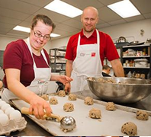
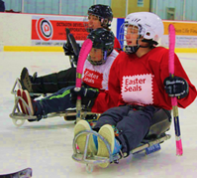
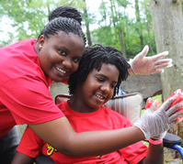
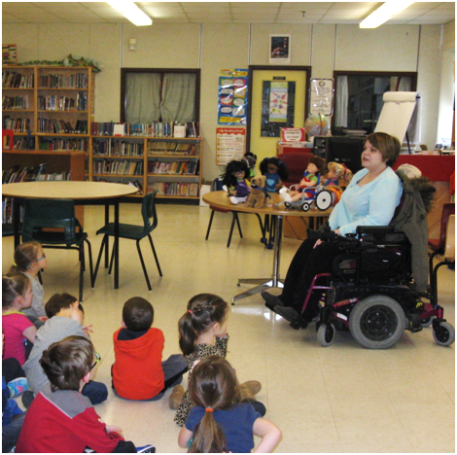
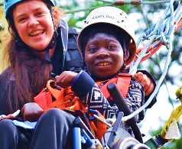
What Does Disability Inclusion Bring to the Workplace?
Special Presentation in Celebration of National AccessAbility Week and Red Shirt Day 2021
Wednesday, June 2, 2021. 1pm – 2pm ET.
www.easterseals.ca

Slide 2
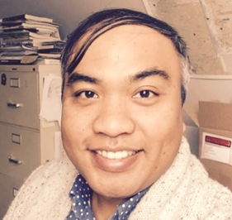

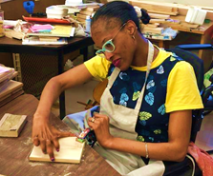
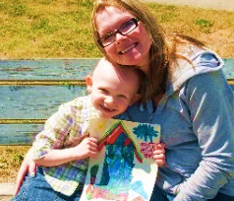
Easter Seals: About Us
Federation of charities dedicated to enhancing the well-being, opportunities and self-determination of Canadians living with disabilities
Programs and services include:
Equipment and technologies
Adaptive sports and recreation programs
Accessible day and overnight camps
Skills-building, employment preparation
Scholarships and bursaries
Casey Sabawi
Senior Manager,
National Corp. Partnerships
Easter Seals Canada
Connect with us
info@easterseals.ca
www.easterseals.ca
Easter Seals: Celebrating 100 years of community service in Canada in 2022.

Slide 3
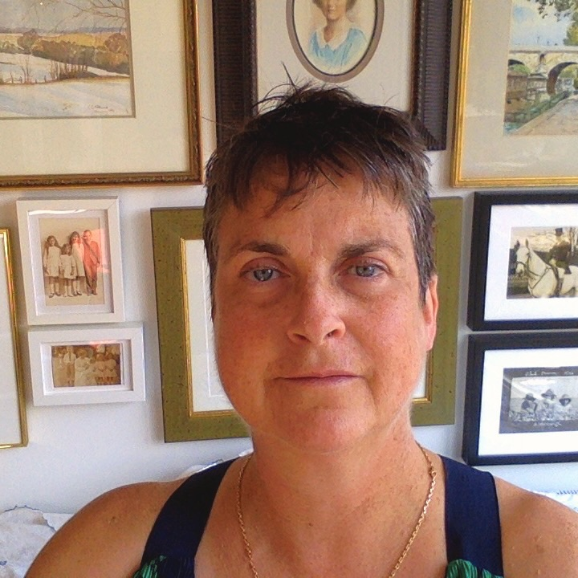
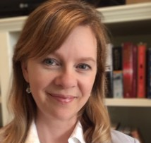
PRESENTERS
Dr Chloë Atkins, PhD
Primary Investigator
The PROUD Project
Associate Professor
Dept of Political Science University of Toronto
Dr Andrea Whiteley, PhD
Postdoctoral Fellow
The PROUD Project
Dept of Political Science
University of Toronto
Easter Seals: Celebrating 100 years of community service in Canada in 2022

Slide 4



What Works
What does disability inclusion bring to the workplace?
Easter Seals of Canada Webinar
2 June 2021
Chloë G. K. Atkins, PhD
Primary Investigator
Andrea Whitely, PhD
Postdoctoral Fellow
The PROUD Project
Department of Political Science,
University of Toronto, UTSC
Red Shirt Day
National AccessAbility Week
30 May – 5 June 2021

Slide 5
Research Team
Chloë Atkins, PhD (primary investigator) is a political and legal theorist with expertise in disability studies, bioethics and human rights.
Andrea Whiteley PhD (PROUD Project postdoctoral fellow) is a communications specialist with expertise in research project management, open access and knowledge mobilization.
Brenna Leslie (research assistant) is a bilingual (French/ English) teacher with a Masters in Library Sciences.
Various undergraduate and graduate research assistants.
Notes:
Andrea

Slide 6
Phenomenological Research Of Underrepresented Disabled
Adults in the Workforces of
Canada, the US, England, France and Belgium
Low rates of the inclusion of qualified, disabled adults continue to plague liberal democracies despite the widespread adoption of legislation mandating workplace accommodations and juridical decisions favouring the inclusion of people with disabilities.
Rather than focusing on barriers to employment for person with disabilities, the aim of this project is to discover why certain disabled individuals manage to gain and retain employment when many of their peers do not do so.
Notes:
Chloe

Slide 7
PROUD Project Research Question
We are interested in what types of environments encourage or allow visibly, physically and sensorially disabled people to enter and remain in the workforce.
WHAT WORKS, and why?

Slide 8
The PROUD Project Activities
 | Research Activities | Funder | Status
PROUD PROJECT QUALITATIVE INTERVIEWS | Multi- national (Canada, USA, UK, France, Belgium) Interviews with persons with visible disabilities who are employed Interviews with employers who hire & retain persons with visible disabilities | SSHRC DNDR Private Donor | In Progress Canadian employee interviews completed
BIBLIOMETRIC ANALYSIS OF DISABILITY & EMPLOYMENT LITERATURE | Meta view of relevant literature of disability & employment literature in various jurisdictions | TechNation Private Donor | Completed
BROADCASTABILITY | Podcast about, by and for people with disabilities and their employment experiences – with Easters Seals of Canada | SSHRC Connections Grant Easter Seals of Canada | In Progress
DISABILITY ETHICS | Research & writing about application of disability ethics to COVID pandemic |  | 1 publication 1 article under review In Progress
Global Teaching and Research | Collaboration with Dr. Alys Young, University of Manchester (UK) | U of T Global Teaching Initiative | Application Submitted
Notes:
1 PROUD PROJECT
CANADA- half –completed – having spoken to employees and entrepreneurs. - now looking for Employers who employ disabled individuals to interview
3. BROADCASTABILITY
Waiting for ethics approval to select podcast participants
Beginning selection of disabled entrepreneurs and workers to
Looking for interviews with indigenous individuals – in order to raise public awareness unique issues surrounding disability and indigeneity

Slide 9
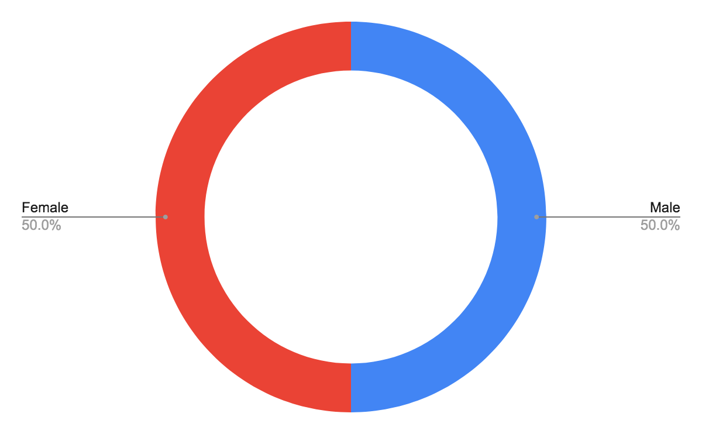
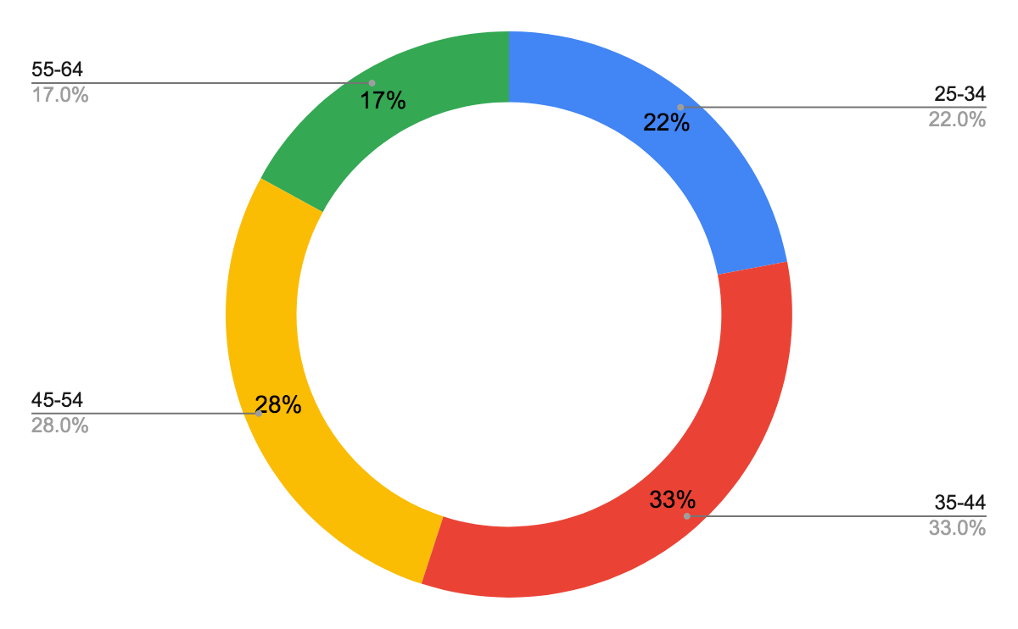
Demographics: Sex and Age
Sex:
Age:

Slide 10
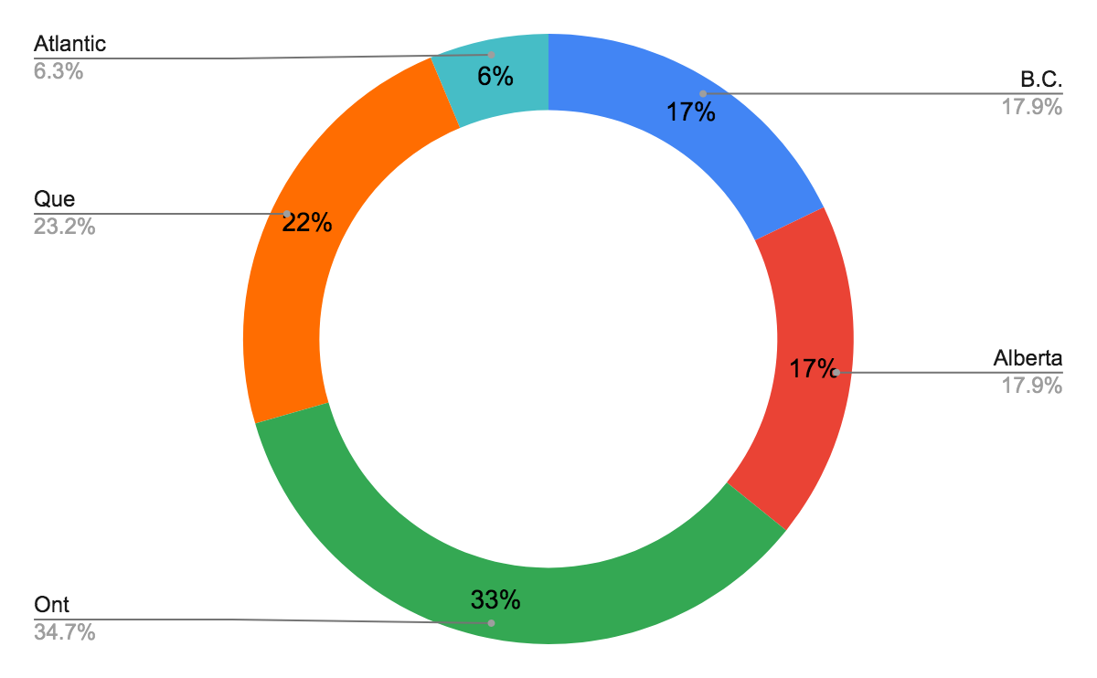
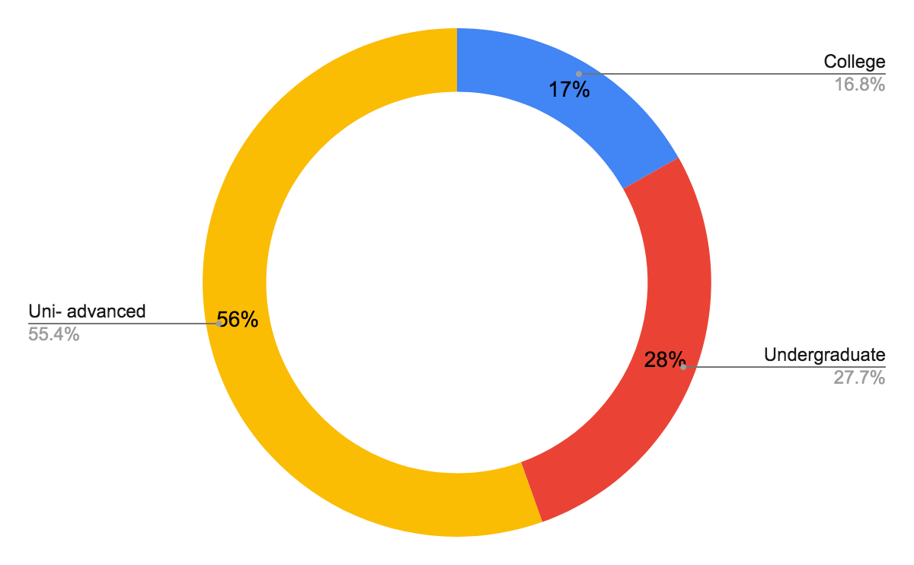
Demographics: Residence & Education
Current residence:
Level of education:

Slide 11

Early Findings
What Works: What Employees Bring to the Workplace
Education
Self awareness
Resourceful & experienced problem-solvers
Flexibility & adaptability
Persistence & resilience
Strong networks, reliable, & accessible transportation and housing

Slide 12
Education and Self-awareness
All participants exhibited a high degree of self-awareness and understanding of their own strengths and weaknesses
And you know, my parents again were very much supportive of my education. And so, because […] we had access to resources, my parents pulled me out of the segregated school because they felt like I wasn't really achieving my potential.
[What’s] been a fundamental strategy for me . . . is, I've used my education as a way of leveraging
Yes. I was offered a position of [software] architect once, which is a quite a step up from what I have, but I realized as a blind person that there were [issues] . . .
I don't want to take a job that I can't do well.
I'm of the opinion if you're disabled you have to be better than average or you don't stick. I've always really worked hard to make sure that I'm at the top of the game.
I've made sure I've learned extra things.

Slide 13
Resourceful Problem-Solvers
Participants universally created unique & workable solutions to challenges
I make my own accommodations, […] I would really not be able to just use everyone’s computer, I have my job computer [… that] I personalize a lot of stuff like changing the color, changing the sizes of everything […]. I use a really big screen […].
I did the modifications myself but that's the kind of accommodations I need.
So normally in our house, the radio goes off with a piece of software that I wrote, so I have a whole house audio system which is really cool [. . .]
I wired it myself.
With disability […] there’s an underlying innovation and creativity, and a sort of "can do" problem solving

Slide 14
Flexibility and Adaptability
Participants find ways to flex and adapt
I guess when you're blind you accept yourself as normal, right? I don't know. I guess when you're disabled, you adapt and you just assume that everyone does these things.
I did the [job] interview. And they were like, “Well, we're not really sure you can work here,” and I'm like, “Why not?” “Well, can you reach the files?” So, I pull out my reacher and I said, “Yeah, I can reach the files.” “Um … can you do this?" “Well, yes I can. If you raised the filing cabinet up just a little bit more, I could do it even better."
I am seated 99% of the time because I have trouble standing, walking and moving around. Luckily, my core strength is rather good so I am not too hampered when I am seated. Because of this, I have had to tailor all the techniques I learned at university. We were taught at university primarily how to use movements while in a standing position. Given my disability, I needed to change those techniques to be able to use them effectively. The patients who know me realize that I carry out my work while seated. That’s not a problem.

Slide 15
Persistence and Resilience
Participants demonstrate resilience when confronting difficulties
When I was first starting out, I did have some difficulties getting jobs and getting interviews and getting taken seriously. And I wasn't sure that it was just because I was another snot-nosed student coming out of the system and they just didn't have time for me. Or if it was because I was that snot-nosed disabled student […]. I didn't know for sure which it was, so I just ended up being persistent.
Ah yeah, I guess one of the one of the first things I would say is, you know: You gotta be resilient because you're gonna get whacked a lot. And you gotta be able to come back and say, you know, “You're not going to get rid of me that easily,” […] Be prepared for that. Because if you're not prepared for that, you're gonna go nowhere.
I remember learning to solder in Grade 6, because I got so miffed of having to ask others […] and when you're holding your handskit iron, it's like 600 degrees Fahrenheit. And you have to know how to do it without getting burned and as a blind person I vowed that I could learn to solder and I did get hurt a few times. But I learned how to solder pretty well, but it was quite an effort to learn how.

Slide 16
Social Support, Transportation, Housing
Participants require stable housing, transportation, and a supportive network to succeed
I couldn't rely on WheelTrans because you know how the paratransit system here is, you have no guarantee that you're actually going to get picked up on time. Or that you're going to get to your location at the time that you want, so Uber made a lot of money off of me.
I deliberately live […] not quite downtown […] I think it’s the most accessible neighbourhood for probably anyone with a disability, […] that getting to work is really easy.
I usually bug coworkers to show me the area and there's a couple that are really good. And I memorize the building, which I can fortunately do really quickly. I have really good geographical map memory. So when I'm shown, I remember, it sticks. Which is handy. And then so I come into work, go to my office, fire up my machine, or log in or whatever, and just do my work. And so if I have to go find someone, I know where people live in the building, I know where their workers are.

Slide 17
Early Findings
What Works in Workplaces
MAIN THEMES
Robust I.T. resources
Relatively low cost physical accommodations
Transportation access
Government and community programs
Leadership creates inclusion
Flexibility, adaptability, & lessons from COVID

Slide 18
Robust I.T. Resources
Employers need to have strong IT capacity
But my advice would be to know your technology, so that you minimize the range of things that you are unable to do, because the technology will facilitate you being able to do these things.
Yeah, probably the big things that you sort of alluded to it, for sure is the computer use. So right now, when I work I've got a laptop that connects to our system, allows me to put all my orders and stuff in. We have medical dictation charting system, so I dictate all my charts […]. So, you know, […] I now have a Bluetooth stethoscope that doesn't go in my ears, I can put headphones in and just use it.
I am always frustrated with my technology. It can always be better. But over the years it has improved. Step by step, but yeah, I think you're right. The computer piece makes a big difference. The dictation piece was ginormous in doing medical dictation because I mean, a bunch of what I do is I write outpatient charts,
right, and put in orders on that I want our team to do. That made a big difference.

Slide 19
Accommodations:
Transportation & Physical Environment
Employers need to provide access
But the accommodation that I tend to need, tend not to carry a whole lot of value. But they have impact for me, but not a whole lot of perceived social value.
[W]e have underground parking […] so I'm very thankful for that particularly on snowy days [...]. There's covered parking […that] is actually kept very well cleared, so I've yet to run into any big trouble.
So the accommodation was a […] physical reorientation of my desk. So it was a wall mounted desk, so we had to kind of disengage it from the wall, and reposition it with another set of walls […] it took about half a day to do. But my employer was pretty gracious about it. And the by-product is that it actually created a more warm and open set up.

Slide 20
Government & Community Programs
Employers need to encourage & be aware of community resources
So originally they bought me a “Dectalk” and that was that little box that talks to me […]. But they bought [it through the] Assistive Devices Program, which is, the government will pay a portion of it.
So, I have a wheelchair accessible van. I got that through […] the Disability Related Employment Services [government] program. So, because at the time when I was coming back, I was doing all sorts of weird hours of shifts […] I couldn't just get around with [paratransit] transit so they actually supported […the ] lift system that went into it.
For me, there's this, in Canada, […] wheelchairs, yeah, there are programs, but it's only partially funded. Oxygen, yeah programs, partially funded a lot of, so that disability is seen as a separate
entity and it doesn't get as much government support. And those individuals, if they had
more access, like guaranteed access to care, they might in fact be able,
if they're not worrying about that, be able to venture further into the world.
20

Slide 21
Leadership
Inclusive workplaces require inclusive cultures
Another one is around document accessibility. Like one of the things, I think our [leadership] group is going to work on […] is an accessibility strategy. So, the way I broadly define it, is instead of just fixing problems as they arise, this strategy will figure out a way of actually going out and identifying the challenges proactively and then figuring out plans to remove them.
I would say one of the big things we do is we make people aware of disability awareness. You know, some of the barriers, and that's in the onboarding process. Accessibility is really something that we take from the ground up. So with the design of our offices, they are fully accessible. We have contrast in our walls in terms of color, we've got a different texture pattern on corners, so that somebody who is blind or vision impaired would know, “Oh, a corner's coming up.” […]Yeah we have a QR code for in front of everyone's work station. And so persons who are blind, who need an app, the app will read out whose office here at or whose desk you're at.
“Corporate mindfulness about disability inclusion”

Slide 22
Lessons from COVID
Virtual work & flexible schedules made employees more productive
I think it has helped employers to see what's possible […]. Up until last March nobody was allowed to work remotely. It will never work. There's no way. And now everybody is working remotely. But I think it's really allowed all of us to re examine the way we employ people, for better and for worse I would say.
I'm thriving in this pandemic […]. I don't have to deal with the constant paratransit and all of those micro aggressions […] just all of this was weighing so much on me. I will definitely ask my boss not to go back to work there
I feel like I've just made so many more connections since Covid because we have the time, we're home. I'm always reachable pretty much right? Or if I'm not I'll get back to you in 10 minutes.

Slide 23
Concluding Thoughts
Statistics vary but between 20-25% of the adult population is disabled in North America.
It is projected that developed countries will continue to experience skilled labour shortages.
Disabled adults are an under-utilized, highly-qualified, adaptive, and resilient labour pool available for employment.
Andrea Whiteley
Postdoctoral Fellow
The PROUD Project
Department of Political Science
University of Toronto, UTSC
andrea.whitely@utoronto.ca
Chloë G. K. Atkins
Primary Investigator
The PROUD Project
Associate Professor
Department of Political Science
University of Toronto, UTSC
chloegk.atkins@utoronto.ca

